Slide 1

Modeling III

Slide 2
Introduction
Instructions
Download Supplement
Unzip Folder
Required Packages
Open .Rmd File and Knit
Within R, Run all Code Chunks for Parts 1,2, and 3 (This was Covered in Previous Lecture)
library(tidyverse)
library(modelr)
library(xtable)

Slide 3
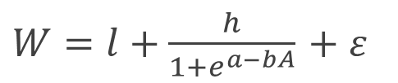
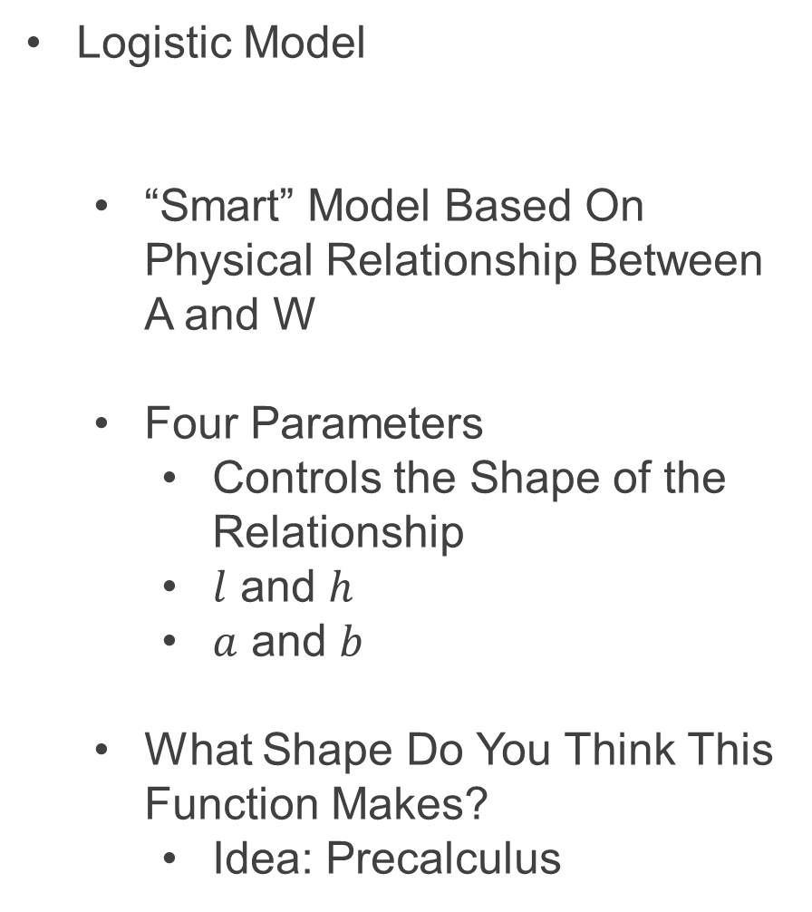
Part 4: Logistic Model
Logistic Model
“Smart” Model Based On Physical Relationship Between A and W
Four Parameters
Controls the Shape of the Relationship
$l$ and $h$
$a$ and $b$
What Shape Do You Think This Function Makes?
Idea: Precalculus
$W=l+\frac{h}{1+e^{a−bA}}$ $+ ε$

Slide 4
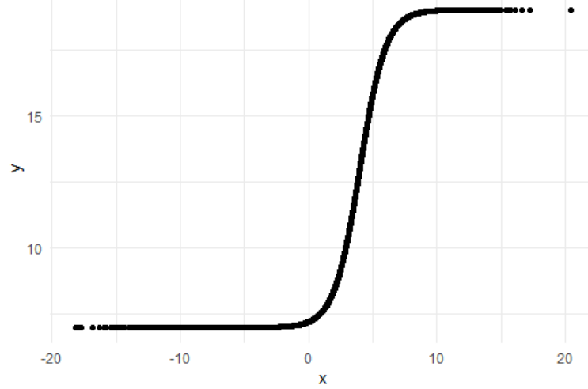
Part 4: Logistic Model
Run Chunk 1
Plant that Seed
Example Model
Parameter Investigation
What Does 7 Represent?
What Does 12 Represent?
What Does 4 Represent?
What Does 1 Represent?

Slide 5
Part 4: Logistic Model
Run Chunk 2
Creation of Modeling Function
Creation of MSE Function Specific to this Model
Run Chunk 3
Use optim() Function With Smart Starting Values Based on Understanding of The Model
Finds Estimates Based on Minimization of MSE

Slide 6
Part 4: Logistic Model
Run Chunk 4
Use Logistic Model Function and Estimated Parameters from optim() to Obtain
Predictions
Residuals

Slide 7
Intermission
Run Code Chunk
save.image() = Used to Save Workspace into .Rdata File
load() = Used to Load Workspace from .Rdata File
.Rdata = File Extension of R Workspace File (All Objects in Global Environment)

Slide 8
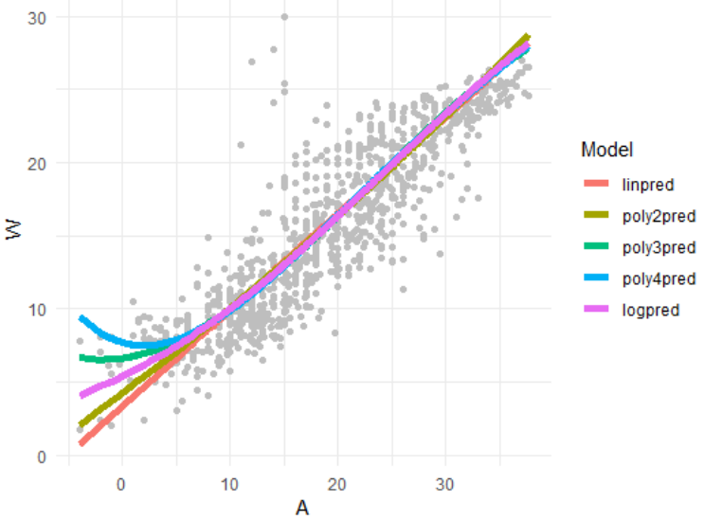
Part 5: Evaluation by Visualization
Run Chunk 1
Plots of Different Models
What Can We Say About the Different Models?
Which Model Would You Use?

Slide 9
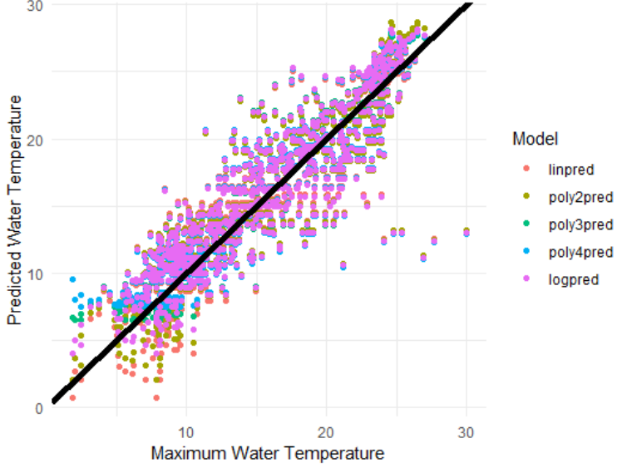
Part 5: Evaluation by Visualization
Run Chunk 2
Comparing Predictions vs Actual Maximum Water Temperatures
Models Give Similar Predictions

Slide 10
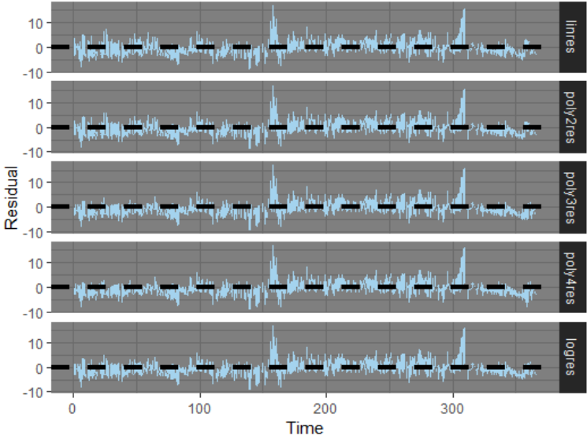
Part 5: Evaluation by Visualization
Run Chunk 3
Shows Residuals Under the 4 Models Plotted Over Time
What is the Problem?

Slide 11
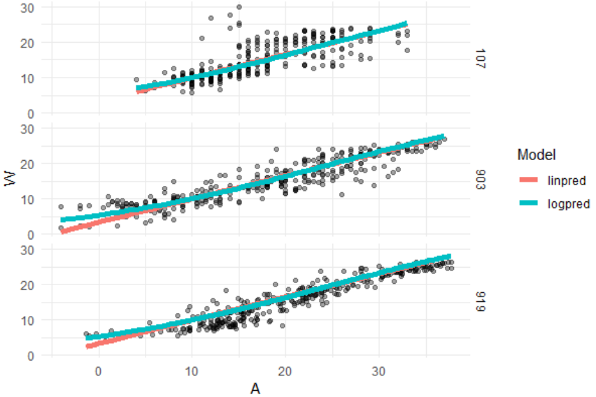
Part 5: Evaluation by Visualization
Run Chunk 4
Evaluate Models For the Three Locations Separately

Slide 12
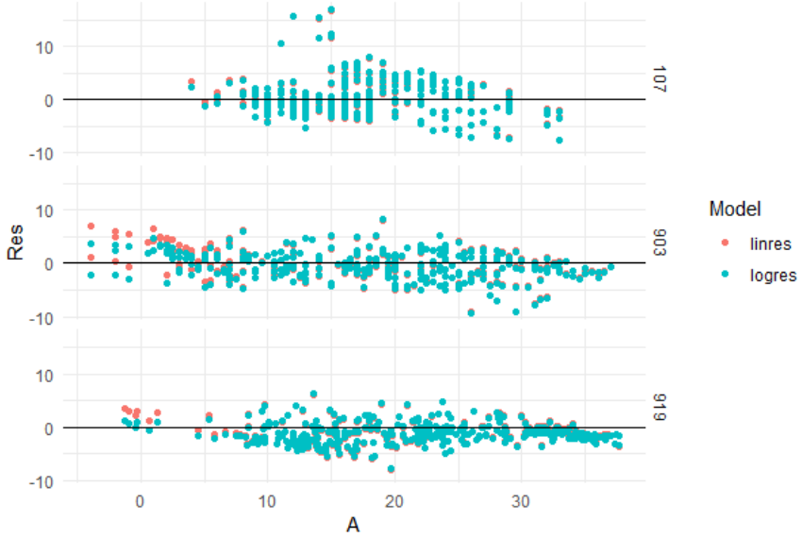
Part 5: Evaluation by Visualization
Run Chunk 5
Evaluate Error For the Three Locations Separately (by A)

Slide 13
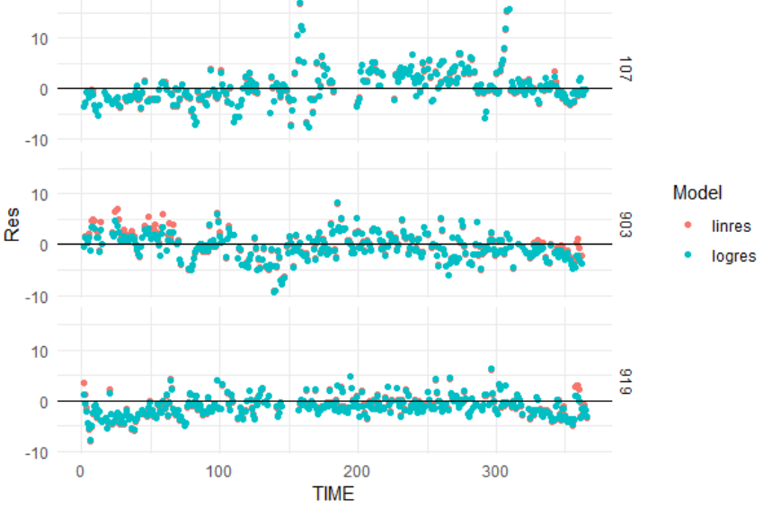
Part 5: Evaluation by Visualization
Run Chunk 6
Evaluate Error For the Three Locations Separately (by Time)

Slide 14
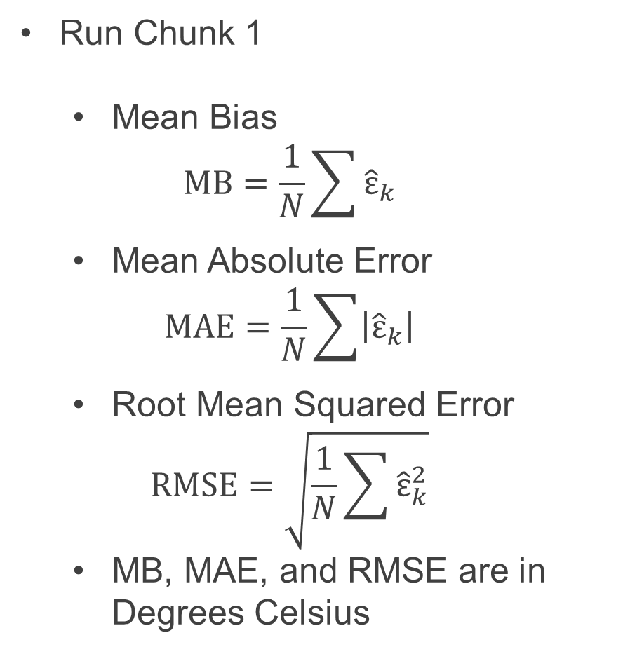
Part 6: Evaluation by Numerical Summary
Run Chunk 1
Mean Bias
$$MB=\frac{1}{N}\sum{{\hat{ε}}_{k}}$$
Mean Absolute Error
$$MAE=\frac{1}{N}\sum{\left|{\hat{ε}}_{k}\right|}$$
Root Mean Squared Error
$$RMSE=\sqrt{\frac{1}{N}\sum{{\hat{ε}}_{k}^{2}}}$$
MB, MAE, and RMSE are in Degrees Celsius

Slide 15
Part 6: Evaluation by Numerical Summary
Summarizing Table
Evaluate MB, MAE, and RMSE on Test Data to Choose Best Model Going Forward
Sketch of Table We Want
Before Writing Code, Have a Plan for the Output
Model | MB | MAE | RMSE
Linear
Poly(2)
Poly(3)
Poly(4)
Logistic

Slide 16
Part 6: Evaluation by Numerical Summary
Chunk 2
Run Line-By-Line
Think About Ways to Quickly Apply All 3 Functions to All Residuals
Run Chunk 3
Combine rename(), gather(), group_by(), and summarize()
Chunk 4
Change eval=F to eval=T and Knit the File (What is Seen?)

Slide 17
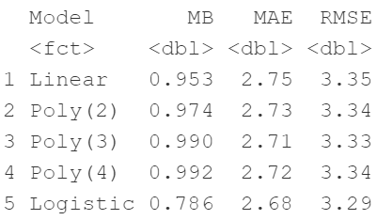
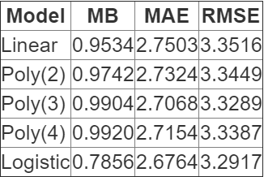
Part 6: Evaluation by Numerical Summary
My Results Based on My Seed
Simple Model that Adequately Predicts
Results=“asis”

Slide 18
Closing
Disperse and Make Reasonable Decisions

